Slide 1
Machine Learning: finding patterns

Slide 2
Outline
Machine learning and Classification
Examples
*Learning as Search
Bias
Weka

Slide 3
Finding patterns
Goal: programs that detect patterns and regularities in the data
Strong patterns ⇒ good predictions
  Problem 1: most patterns are not interesting
  Problem 2: patterns may be inexact (or spurious)
  Problem 3: data may be garbled or missing

Slide 4
Machine learning techniques
Algorithms for acquiring structural descriptions from examples
Structural descriptions represent patterns explicitly
  Can be used to predict outcome in new situation
  Can be used to understand and explain how prediction is derived
  (may be even more important)
Methods originate from artificial intelligence, statistics, and research on databases
witten&eibe

Slide 5
Can machines really learn?
Definitions of “learning” from dictionary:
To get knowledge of by study,
experience, or being taught
To become aware by information or
from observation
To commit to memory
To be informed of, ascertain; to receive instruction
Difficult to measure
Trivial for computers
Operational definition:
Things learn when they change their behavior in a way that makes them perform better in the future.
Does a slipper learn?
Does learning imply intention?
witten&eibe

Slide 6
Classification
Learn a method for predicting the instance class from pre-labeled (classified) instances
Many approaches: Regression,
Decision Trees,
Bayesian,
Neural Networks,
...
Given a set of points from classes
what is the class of new point ?

Slide 7
Classification: Linear Regression
Linear Regression
  w₀ + w₁ x + w₂ y >= 0
Regression computes wi from data to minimize squared error to ‘fit’ the data
Not flexible enough

Slide 8
Classification: Decision Trees
if X > 5 then blue
else if Y > 3 then blue
else if X > 2 then green
else blue
Y
3
2
5
X

Slide 9
Classification: Neural Nets
Can select more complex regions
Can be more accurate
Also can overfit the data – find patterns in random noise

Slide 10
Outline
Machine learning and Classification
Examples
*Learning as Search
Bias
Weka

Slide 11
The weather problem
Outlook | Temperature | Humidity | Windy | Play
sunny | 85 | 85 | false | no
sunny | 80 | 90 | true | no
overcast | 83 | 86 | false | yes
rainy | 70 | 96 | false | yes
rainy | 68 | 80 | false | yes
rainy | 65 | 70 | true | no
overcast | 64 | 65 | true | yes
sunny | 72 | 95 | false | no
sunny | 69 | 70 | false | yes
rainy | 75 | 80 | false | yes
sunny | 75 | 70 | true | yes
overcast | 72 | 90 | true | yes
overcast | 81 | 75 | false | yes
rainy | 71 | 91 | true | no
Given past data,
Can you come up
with the rules for
Play/Not Play ?
What is the game?

Slide 12

The weather problem
Conditions for playing golf
Outlook | Temperature | Humidity | Windy | Play
Sunny | Hot | High | False | No
Sunny | Hot | High | True | No
Overcast | Hot | High | False | Yes
Rainy | Mild | Normal | False | Yes
… | … | … | … | …
If outlook = sunny and humidity = high then play = no If outlook = rainy and windy = true then play = no If outlook = overcast then play = yes If humidity = normal then play = yes If none of the above then play = yes
witten&eibe

Slide 13
Weather data with mixed attributes
Some attributes have numeric values
Outlook | Temperature | Humidity | Windy | Play
Sunny | 85 | 85 | False | No
Sunny | 80 | 90 | True | No
Overcast | 83 | 86 | False | Yes
Rainy | 75 | 80 | False | Yes
… | … | … | … | …
If outlook = sunny and humidity > 83 then play = no If outlook = rainy and windy = true then play = no If outlook = overcast then play = yes If humidity < 85 then play = yes If none of the above then play = yes
witten&eibe

Slide 14
The contact lenses data
Age | Spectacle prescription | Astigmatism | Tear production rate | Recommended lenses
Young | Myope | No | Reduced | None
Young | Myope | No | Normal | Soft
Young | Myope | Yes | Reduced | None
Young | Myope | Yes | Normal | Hard
Young | Hypermetrope | No | Reduced | None
Young | Hypermetrope | No | Normal | Soft
Young | Hypermetrope | Yes | Reduced | None
Young | Hypermetrope | Yes | Normal | hard
Pre-presbyopic | Myope | No | Reduced | None
Pre-presbyopic | Myope | No | Normal | Soft
Pre-presbyopic | Myope | Yes | Reduced | None
Pre-presbyopic | Myope | Yes | Normal | Hard
Pre-presbyopic | Hypermetrope | No | Reduced | None
Pre-presbyopic | Hypermetrope | No | Normal | Soft
Pre-presbyopic | Hypermetrope | Yes | Reduced | None
Pre-presbyopic | Hypermetrope | Yes | Normal | None
Presbyopic | Myope | No | Reduced | None
Presbyopic | Myope | No | Normal | None
Presbyopic | Myope | Yes | Reduced | None
Presbyopic | Myope | Yes | Normal | Hard
Presbyopic | Hypermetrope | No | Reduced | None
Presbyopic | Hypermetrope | No | Normal | Soft
Presbyopic | Hypermetrope | Yes | Reduced | None
Presbyopic | Hypermetrope | Yes | Normal | None
witten&eibe

Slide 15
A complete and correct rule set
If tear production rate = reduced then recommendation = none If age = young and astigmatic = no and tear production rate = normal then recommendation = soft If age = pre-presbyopic and astigmatic = no and tear production rate = normal then recommendation = soft If age = presbyopic and spectacle prescription = myope and astigmatic = no then recommendation = none If spectacle prescription = hypermetrope and astigmatic = no and tear production rate = normal then recommendation = soft If spectacle prescription = myope and astigmatic = yes and tear production rate = normal then recommendation = hard If age young and astigmatic = yes and tear production rate = normal then recommendation = hard If age = pre-presbyopic and spectacle prescription = hypermetrope and astigmatic = yes then recommendation = none If age = presbyopic and spectacle prescription = hypermetrope and astigmatic = yes then recommendation = none
witten&eibe

Slide 16
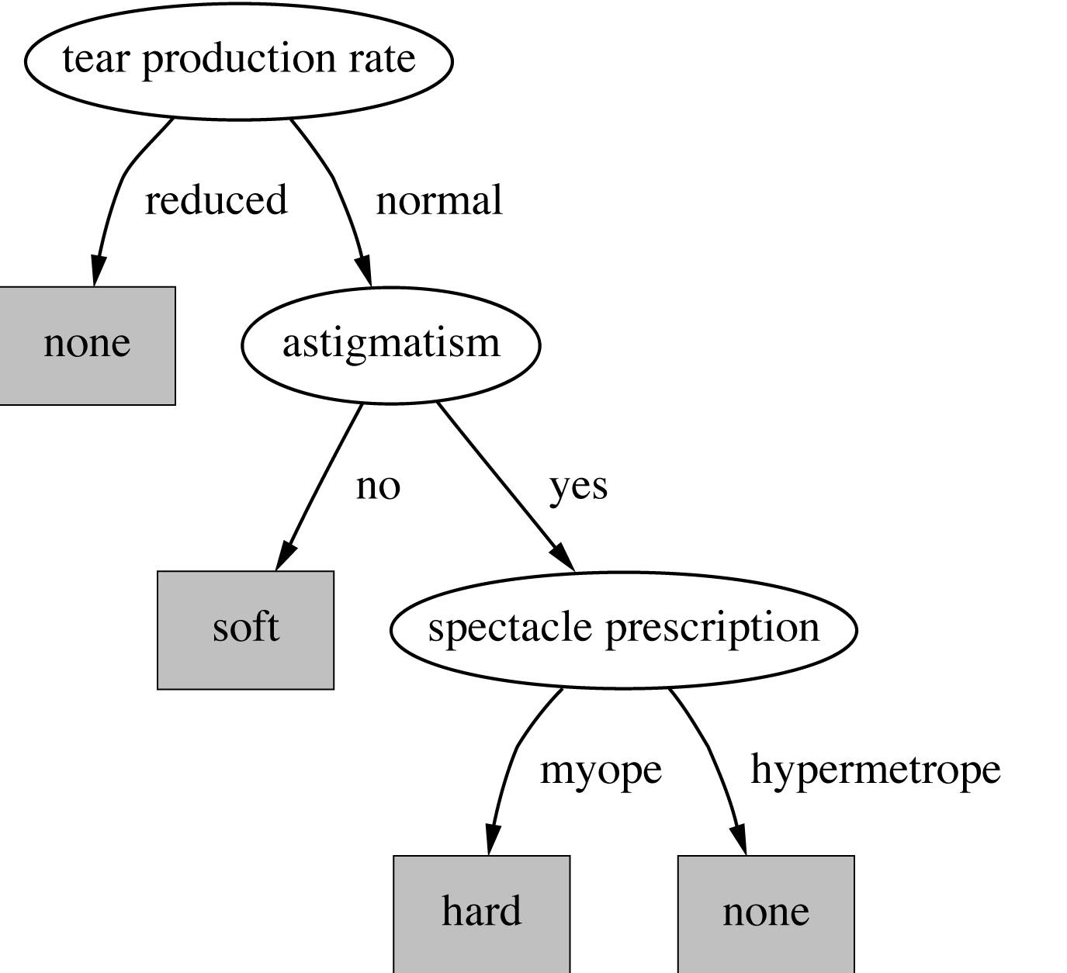
A decision tree for this problem
witten&eibe

Slide 17
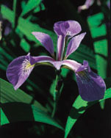
Classifying iris flowers
 | Sepal length | Sepal width | Petal length | Petal width | Type
1 | 5.1 | 3.5 | 1.4 | 0.2 | Iris setosa
2 | 4.9 | 3.0 | 1.4 | 0.2 | Iris setosa
…
51 | 7.0 | 3.2 | 4.7 | 1.4 | Iris versicolor
52 | 6.4 | 3.2 | 4.5 | 1.5 | Iris versicolor
…
101 | 6.3 | 3.3 | 6.0 | 2.5 | Iris virginica
102 | 5.8 | 2.7 | 5.1 | 1.9 | Iris virginica
…
If petal length < 2.45 then Iris setosa If sepal width < 2.10 then Iris versicolor ...
witten&eibe

Slide 18
Predicting CPU performance
Example: 209 different computer configurations
Linear regression function
 | Cycle time (ns) | Main memory (Kb) |  | Cache (Kb) | Channels |  | Performance
 | MYCT | MMIN | MMAX | CACH | CHMIN | CHMAX | PRP
1 | 125 | 256 | 6000 | 256 | 16 | 128 | 198
2 | 29 | 8000 | 32000 | 32 | 8 | 32 | 269
…
208 | 480 | 512 | 8000 | 32 | 0 | 0 | 67
209 | 480 | 1000 | 4000 | 0 | 0 | 0 | 45
PRP = -55.9 + 0.0489 MYCT + 0.0153 MMIN + 0.0056 MMAX + 0.6410 CACH - 0.2700 CHMIN + 1.480 CHMAX
witten&eibe

Slide 19
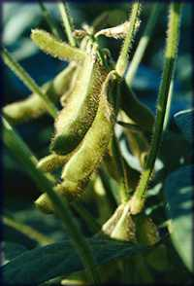
Soybean classification
 | Attribute | Number of values | Sample value
Environment | Time of occurrence | 7 | July
 | Precipitation | 3 | Above normal
…
Seed | Condition | 2 | Normal
 | Mold growth | 2 | Absent
…
Fruit | Condition of fruit pods | 4 | Normal
 | Fruit spots | 5 | ?
Leaves | Condition | 2 | Abnormal
 | Leaf spot size | 3 | ?
…
Stem | Condition | 2 | Abnormal
 | Stem lodging | 2 | Yes
…
Roots | Condition | 3 | Normal
Diagnosis |  | 19 | Diaporthe stem canker
witten&eibe

Slide 20
The role of domain knowledge
If leaf condition is normal and stem condition is abnormal and stem cankers is below soil line and canker lesion color is brown then diagnosis is rhizoctonia root rot
If leaf malformation is absent and stem condition is abnormal and stem cankers is below soil line and canker lesion color is brown then diagnosis is rhizoctonia root rot
But in this domain, “leaf condition is normal” implies
“leaf malformation is absent”!
witten&eibe

Slide 21
Outline
Machine learning and Classification
Examples
*Learning as Search
Bias
Weka

Slide 22
Learning as search
Inductive learning: find a concept description that fits the data
Example: rule sets as description language
  Enormous, but finite, search space
Simple solution:
  enumerate the concept space
  eliminate descriptions that do not fit examples
  surviving descriptions contain target concept
witten&eibe

Slide 23
Enumerating the concept space
Search space for weather problem
  4 x 4 x 3 x 3 x 2 = 288 possible combinations
  With 14 rules ⇒ 2.7x10³⁴ possible rule sets
Solution: candidate-elimination algorithm
Other practical problems:
  More than one description may survive
  No description may survive
    Language is unable to describe target concept
    or data contains noise
witten&eibe

Slide 24
The version space
Space of consistent concept descriptions
Completely determined by two sets
  L: most specific descriptions that cover all positive examples and no negative ones
  G: most general descriptions that do not cover any negative examples and all positive ones
Only L and G need be maintained and updated
But: still computationally very expensive
And: does not solve other practical problems
witten&eibe

Slide 25
*Version space example
Given: red or green cows or chicken
L={} G={<*, *>} <green,cow>: positive L={<green, cow>} G={<*, *>} <red,chicken>: negative L={<green, cow>} G={<green,*>,<*,cow>} <green, chicken>: positive L={<green, *>} G={<green, *>}
witten&eibe

Slide 26
*Candidate-elimination algorithm
Initialize L and G For each example e: If e is positive: Delete all elements from G that do not cover e For each element r in L that does not cover e: Replace r by all of its most specific generalizations that 1. cover e and 2. are more specific than some element in G Remove elements from L that are more general than some other element in L If e is negative: Delete all elements from L that cover e For each element r in G that covers e: Replace r by all of its most general specializations that 1. do not cover e and 2. are more general than some element in L Remove elements from G that are more specific than some other element in G
witten&eibe

Slide 27
Outline
Machine learning and Classification
Examples
*Learning as Search
Bias
Weka

Slide 28
Bias
Important decisions in learning systems:
  Concept description language
  Order in which the space is searched
  Way that overfitting to the particular training data is avoided
These form the “bias” of the search:
  Language bias
  Search bias
  Overfitting-avoidance bias
witten&eibe

Slide 29
Language bias
Important question:
  is language universal
  or does it restrict what can be learned?
Universal language can express arbitrary subsets of examples
If language includes logical or (“disjunction”), it is universal
Example: rule sets
Domain knowledge can be used to exclude some concept descriptions a priori from the search
witten&eibe

Slide 30
Search bias
Search heuristic
  “Greedy” search: performing the best single step
  “Beam search”: keeping several alternatives
  …
Direction of search
  General-to-specific
    E.g. specializing a rule by adding conditions
  Specific-to-general
    E.g. generalizing an individual instance into a rule
witten&eibe

Slide 31
Overfitting-avoidance bias
Can be seen as a form of search bias
Modified evaluation criterion
  E.g. balancing simplicity and number of errors
Modified search strategy
  E.g. pruning (simplifying a description)
    Pre-pruning: stops at a simple description before search proceeds to an overly complex one
    Post-pruning: generates a complex description first and simplifies it afterwards
witten&eibe

Slide 32
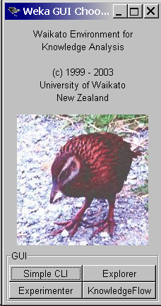
Weka

